Slide 1
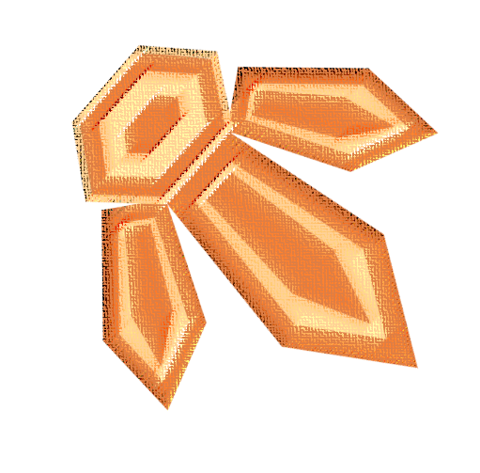
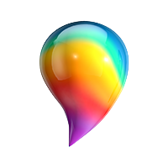
CREATING IDENTITY SELF-PORTRAITURE UTILIZING PAINT 3D
GENESIS DELGADO
KATELYN JAFAREY
CLARK NGUYEN
TONY PANTALEO
ART 305
APP LESSON PLAN
CREATED BY

Slide 2
DESCRIPTION OF LESSON
UTILIZING THE FREE WINDOWS COMPUTER APPLICATION PAINT 3D, STUDENTS WILL CREATE A GRAPHIC DESIGN PIECE WITH TEXT, SHAPES, AND IMAGES THAT SYMBOLICALLY COMMUNICATES THEIR INDIVIDUAL PERSONAL IDENTITY.
THEY WILL BEGIN THE LESSON BY LEARNING ABOUT AND ANALYZING A FEW ART HISTORICALLY SIGNIFICANT PORTRAITS AND SELF-PORTRAITS, SO AS TO GAIN A CONCEPTUAL UNDERSTANDING OF PORTRAITURE AND SELF-PORTRAITURE. STUDENTS WILL COMPLETE A DESIGN WORKSHEET FEATURING WRITTEN AND DRAWN RESPONSES, WHICH WILL HELP
THEM ARTICULATE THE COMPONENTS OF THEIR
IDENTITIES. AS STUDENTS DESIGN AND CREATE
THEIR PIECES, THEY WILL LEARN HOW TO
AESTHETICALLY AND FIGURATIVELY
DELINEATE THE IDEAS, FEELINGS,
AND ASSOCIATIONS.

Slide 3
BIG QUESTION
HOW DOES THE STYLE OF A PORTRAIT CAPTURE AND COMMUNICATE THE IDENTITIES OF THE ARTIST AND SUBJECT OF THE PAINTING?

Slide 4
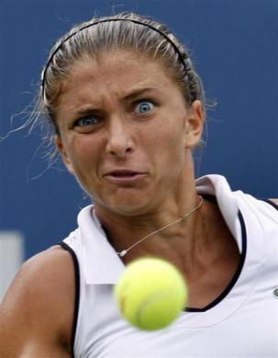
ANTICIPATION SET: BALL TOSS GAME
A SMALL BALL WILL BE TOSSED AROUND THE CLASSROOM IN A RANDOM DIRECTION
WHOEVER IN CAUGHT THE BALL WILL ANSWER A FEW QUESTIONS ABOUT THEMSELVES AND THEN TOSS IT TO ANOTHER RANDOM STUDENT

Slide 5
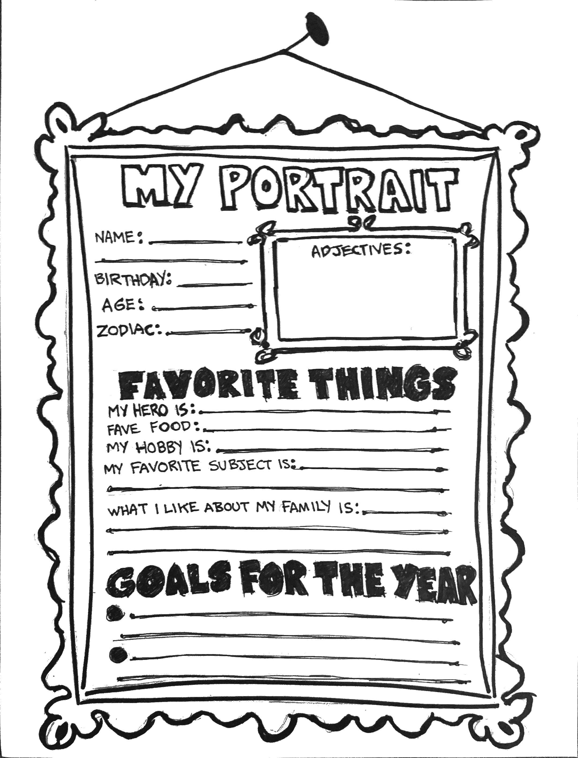
STUDENT
IDENTITY
WORKSHEET

Slide 6
PAINT 3D INTERFACE
OPEN PAINT- SELECT MENU AND CLICK ON “NEW” TO MAKE A NEW PROJECT
BY DEFAULT THE PROGRAM WILL OPEN WITH A BLANK CANVAS READY
CLICK ON “BRUSHES” TO SEE BRUSH OPTIONS ON THE RIGHT HAND TAB
BRUSH OPTIONS INCLUDE:
MARKER - CALLIGRAPHY PEN
- OIL BRUSH - WATERCOLOR
- PIXEL PE - PENCIL
- ERASER - CRAYON
- SPRAY CAN - FILL
THE FAR ARROW DISPLAY THE NAMES OF EACH TOOL. LOCATED NEXT TO THE TOGGLE IS THE “REDO”, “HISTORY”, “UNDO” , AND “PASTE”. THE UNDO BUTTON GOES BACK ONE ACTION FROM THE MOST RECENT ACTION YOU TOOK WHILE USING THE TOOL. THE REDO BUTTON TAKES YOU BACK TO YOUR MOST RECENT ACTION. THE “HISTORY” BUTTON LETS YOU SCROLL THROUGH EVERY ACTION YOU TOOK IN THE PROGRAM. “PASTE” CAN PUT ANY IMAGE YOU RECENTLY COPY ONTO THE CANVAS.

Slide 7
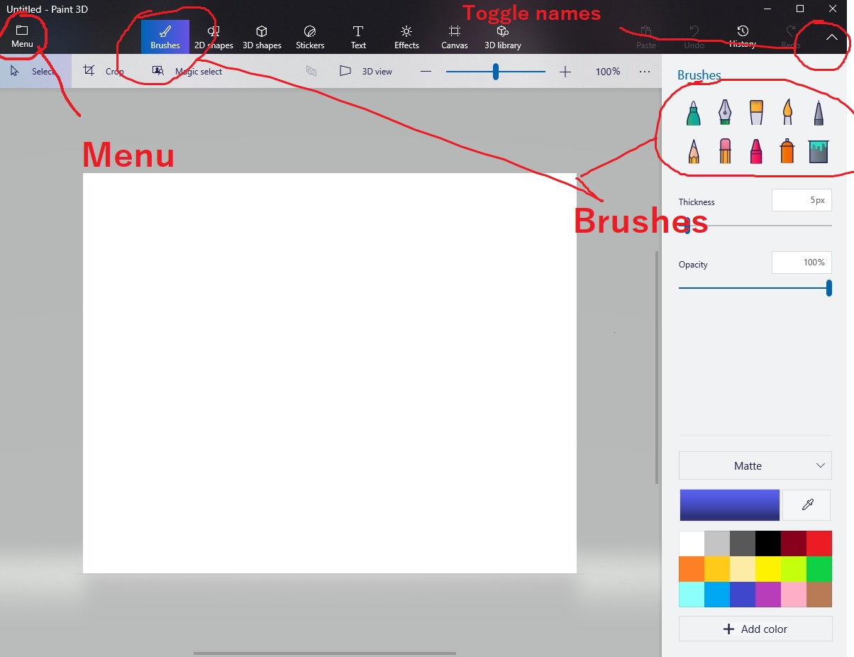

Slide 8
2D SHAPE
CLICKING ON THE “2D SHAPE” BRINGS UP A TAB WHERE YOU CAN SELECT FROM DIFFERENT LINES AND SHAPES TO PUT ON YOUR CANVAS.
CLICKING ON A SHAPE AND THEN CLICKING ON THE CANVAS WILL BRING UP THE SHAPE ALONG WITH A PANEL ON THE RIGHT HAND SIDE THAT WILL EDIT THE SHAPE BEFORE LETTING THE SHAPE STICK ONTO THE CANVAS. FROM THERE, YOU CAN CHANGE THE COLOR OF YOUR SHAPE AND THE THICKNESS OF THE LINES.
THE LEFT TAB COMING FROM THE SHAPE CAN CLONE THE SHAPE. YOU CAN DRAG THE SHAPE AROUND AND CLICK ON THE CLONE BUTTON TO MAKE AS MANY COPIES OF THE SHAPE AS YOU WANT. THE TOP TAB CAN USE TO ROTATE THE SHAPE. WHEN YOU'RE DONE WITH POSITIONING THE SHAPE, PRESS THE TAB WITH THE CHECK MARK TO THE RIGHT OF IT TO KEEP THE SHAPE THERE.
-

Slide 9
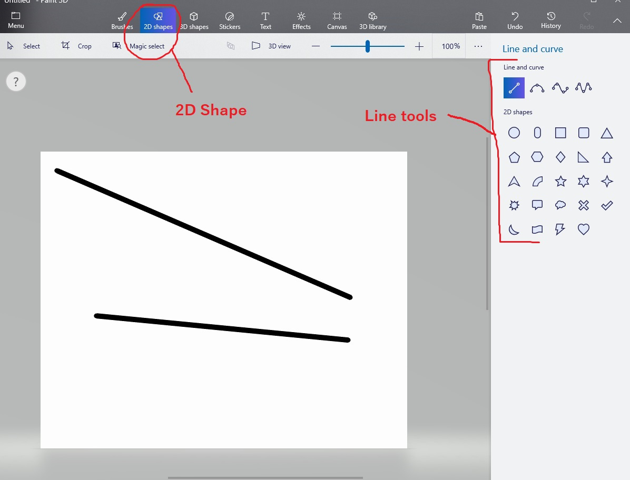

Slide 10
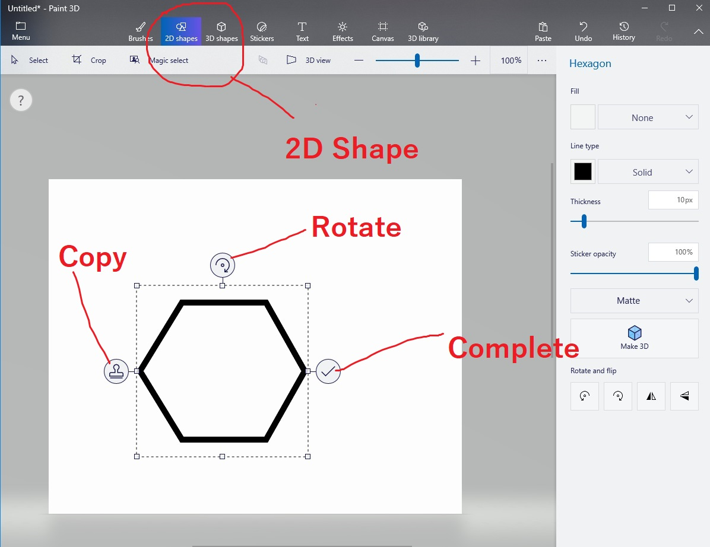

Slide 11
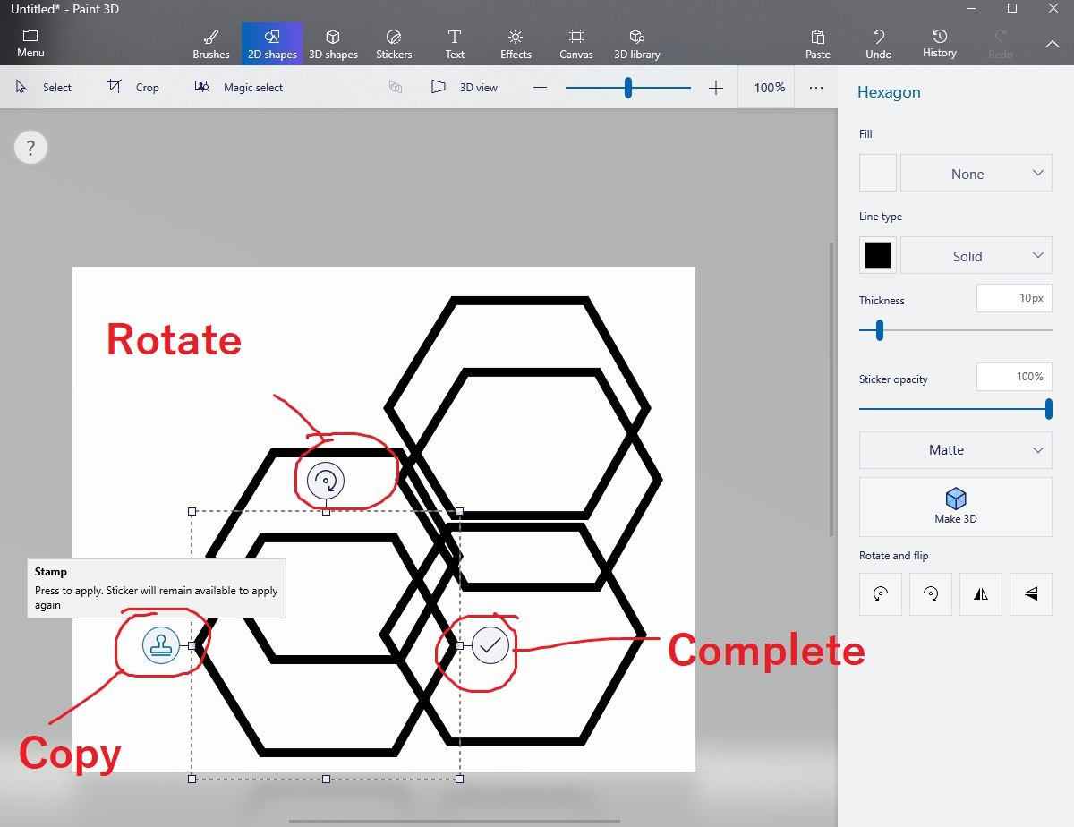

Slide 12
3D SHAPES
CLICK ON THE 3D MODEL OF YOUR CHOICE AND THEN CLICK ON THE CANVAS TO BRING UP THE MODEL.
SIMILAR TO 2D SHAPES, THERE IS A 3D SHAPES OPTION
LOCATED NEXT TO FROM. CLICK ON IT AND IT WILL BRING UP
DIFFERENT SHAPES FOR YOU TO PICK FROM ON THE TAB TO THE RIGHT HAND SIDE
THE 3D VIEW BUTTON, LOCATED NEXT TO THE ZOOM, ALLOW YOU TO SEE WHAT THE OBJECT LOOK LIKE IN 3D SPACE.
UNLIKE 2D OBJECTS, YOU CAN EDIT YOUR 3D MODEL BY LEFT CLICKING ON IT AT ANY TIME ONCE.
SIMILAR TO 2D SHAPES, THERE IS A 3D SHAPES OPTION LOCATED NEXT TO FROM. CLICK ON IT AND IT WILL BRING UP DIFFERENT SHAPES FOR YOU TO PICK FROM ON THE TAB TO THE RIGHT HAND SIDE
THE GRAPH THAT COMES UP WHEN CLICKING ON
THE 3D VIEW BUTTON SITS IN THE MIDDLE OF
THE OBJECT AND ALLOW YOU TO SEE WHERE THE
OBJECT SITS IN THE SPACE.
LEFT CLICKING THE OBJECT WILL ALSO HIGHLIGHT
IT AND BEING UP EDITING OPTIONS ON THE RIGHT
HAND SIDE.

Slide 13
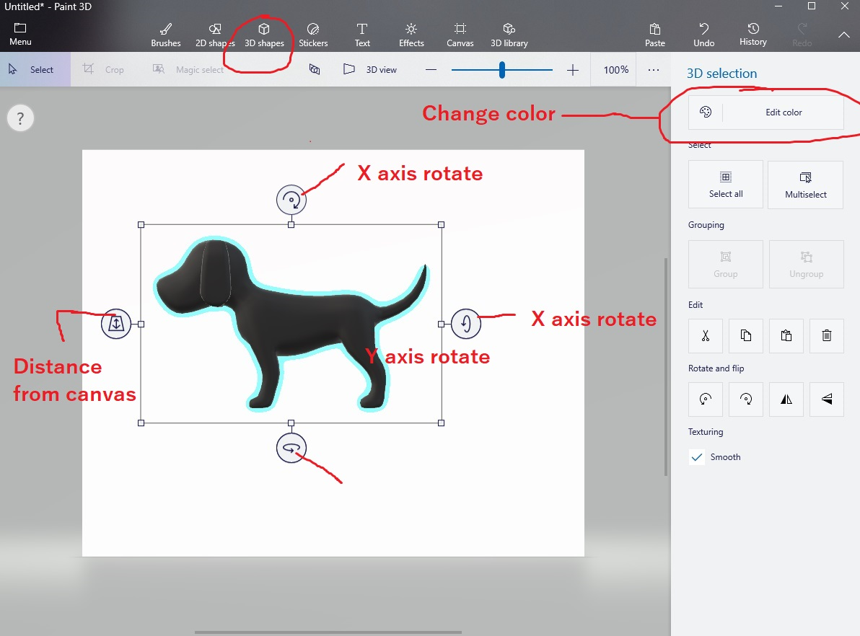

Slide 14
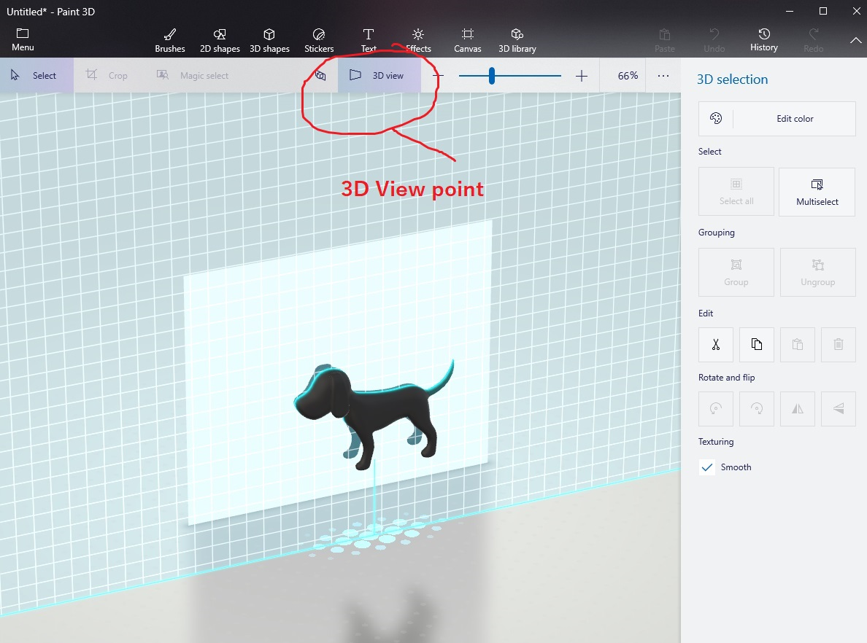

Slide 15
3D BRUSHES
IN THE MENU WHERE THE 3D SHAPES ARE LOCATED, THERE ARE 3 BRUSH OPTIONS FOR DRAWING IN 3D.
THE TUBE BRUSH CAN BE DRAWN JUST LIKE ANY REGULAR BRUSH WHILE THE CANVAS IS IN 2D VIEW
THE SHARP EDGE BRUSH AND THE SOFT EDGE BRUSH WORKS MUCH LIKE THE LINE TOOL WHERE YOU HAVE TO SELECT AN AREA AND THEN DRAG IT TO ANOTHER SPOT AND LEFT CLICK TO MAKE A LINE BETWEEN THE TWO SPOTS
EFFECTS
THE “EFFECTS” TAB ON TOP ALLOW DIFFERENT OPTIONS FOR LIGHTING 3D MODELS SIMPLY BY ROTATING THE SUN ICON.
THE CIRCLE INSIDE THE SUN REPRESENT WHERE THE OBJECT SITS, AND THE POSITION OF THE SUN IS THE DIRECTION WHERE LIGHT WILL HIT THE OBJECT.

Slide 17
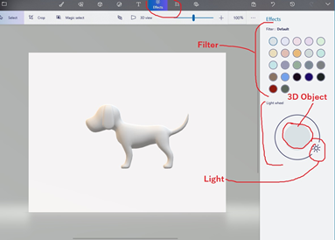

Slide 18
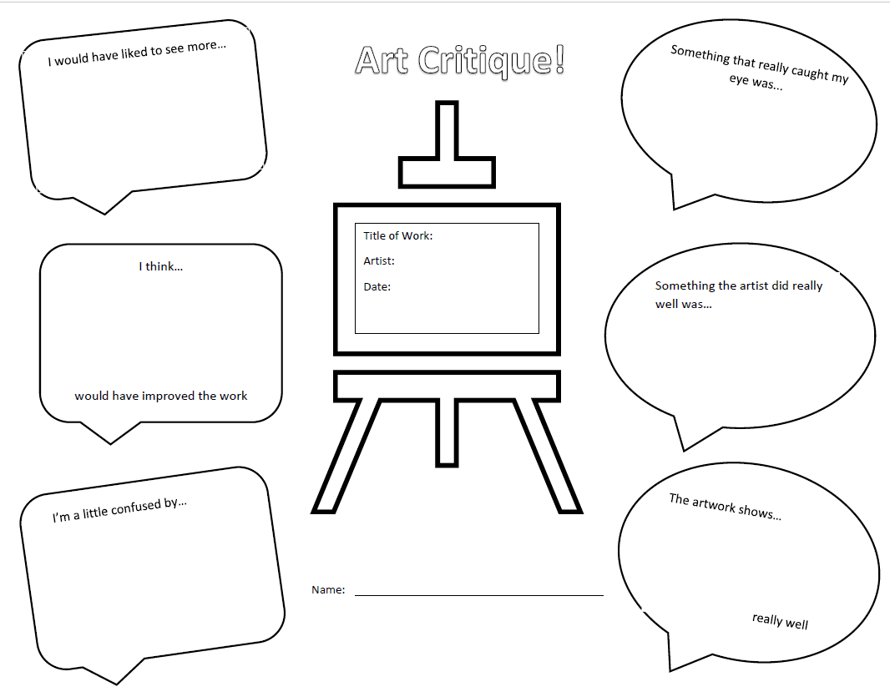
ASSESSMENT:
PEER REVIEW“TICKET-OUT”

Slide 20
